Slide 1
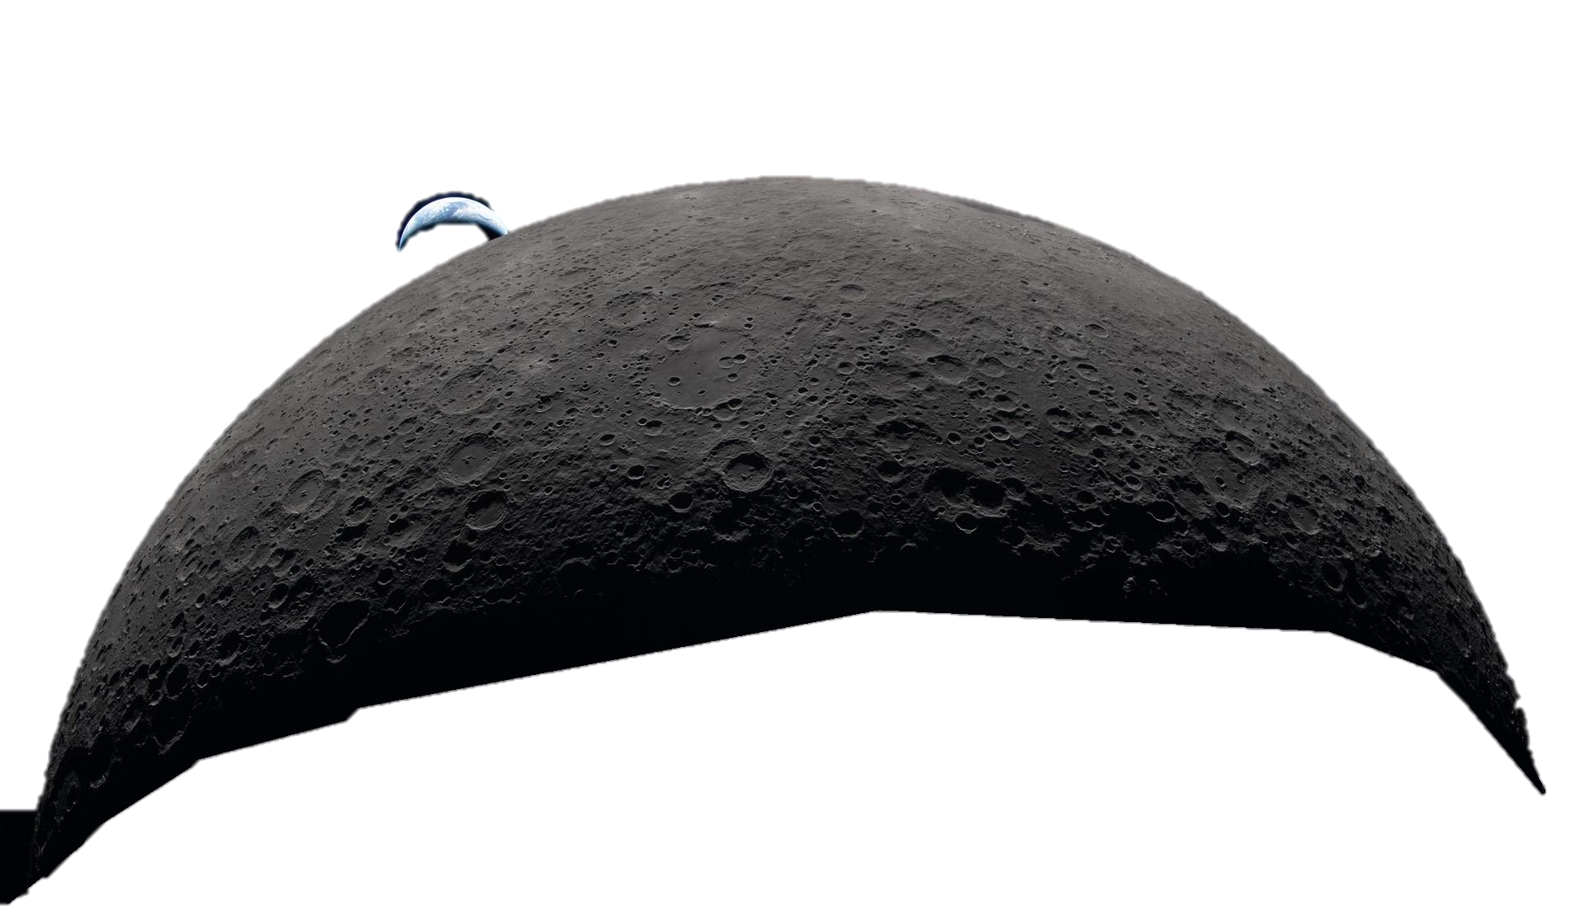




Cataclysm or Creation?
The Surprising Story of How Giant Impacts Shape Humanity
Ari J. Guest
PhD Student, University of Portsmouth

Slide 2
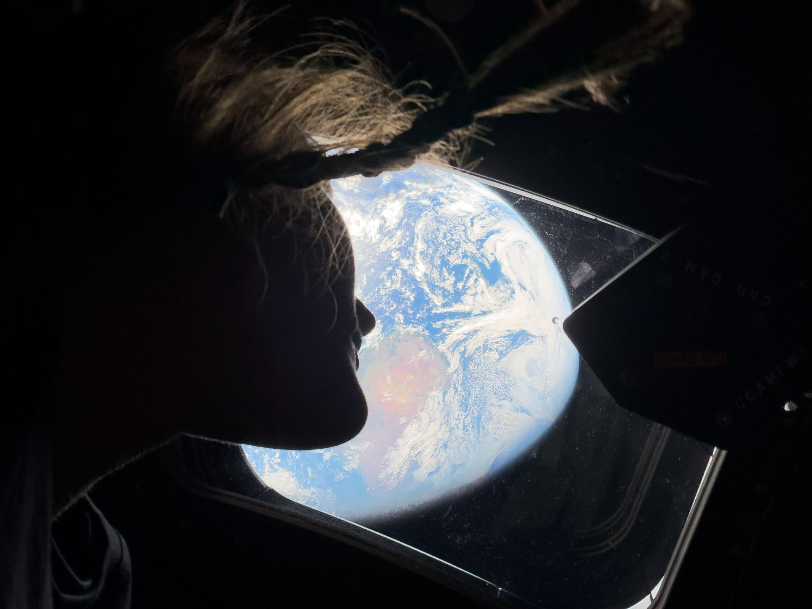
Notes:
Some of you may have noticed Artemis 2… first manned Moon mission since 1972… so this talk is quite topical
Christina Koch, first woman to reach the Moon.

Slide 3
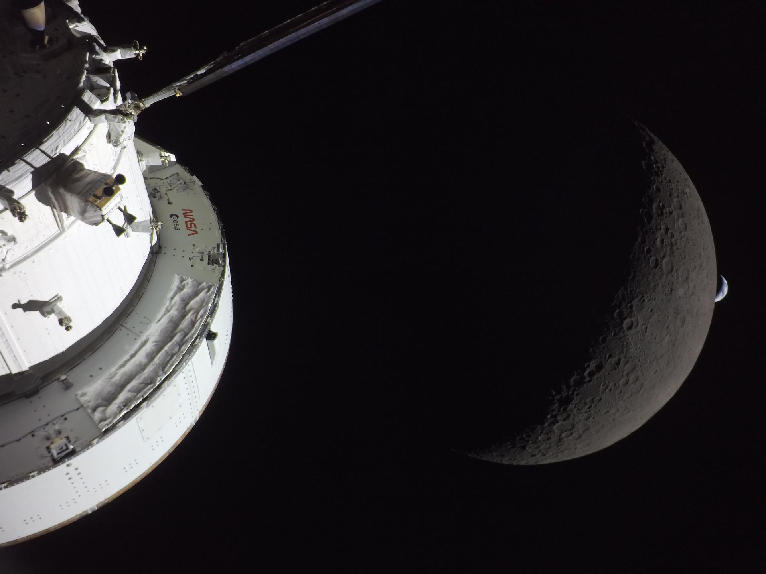
Notes:
Earthset, communications blackout begins

Slide 4
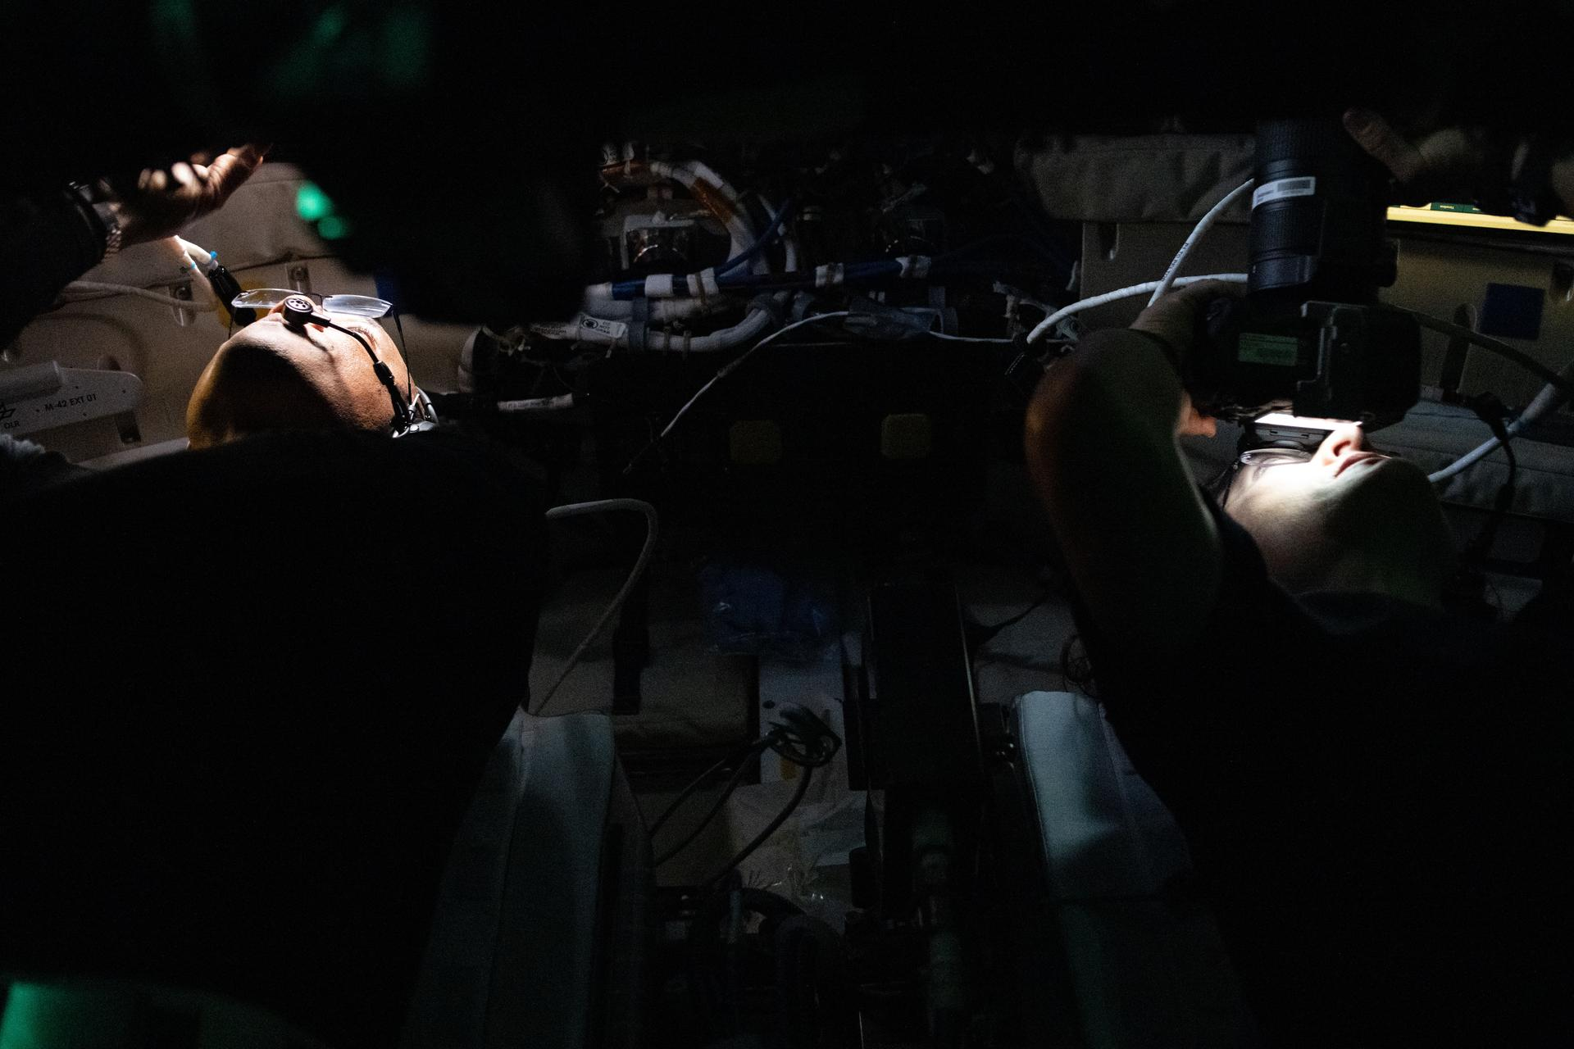
Notes:
Victor Glover (left) Pilot
Christina Koch (right) Mission Specialist

Slide 5
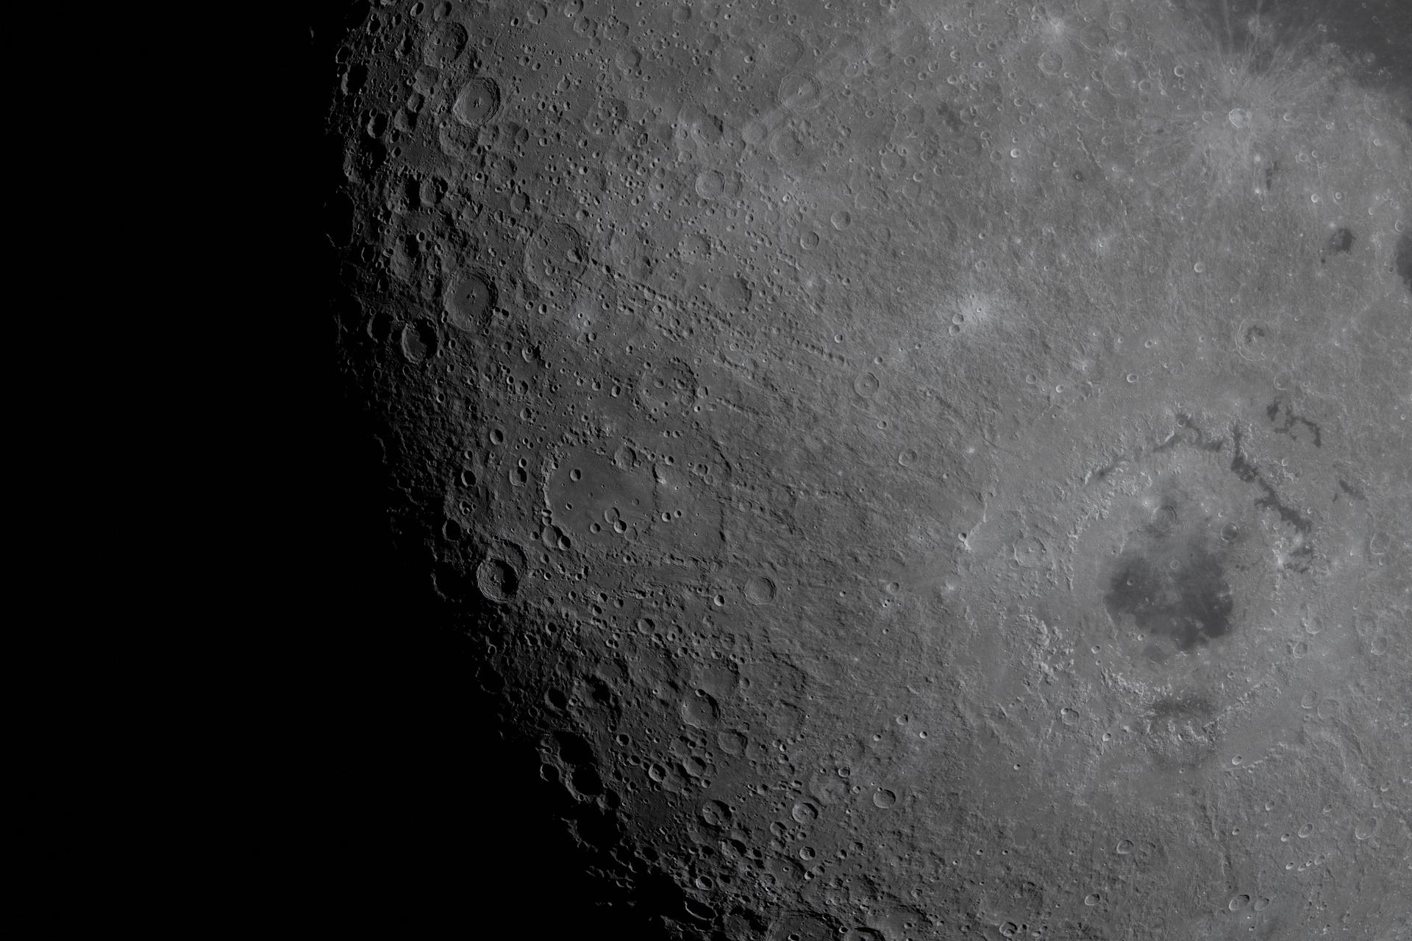
Notes:
Impact flashes… Artemis saw 6 in total… impacts by small specks of dust
Probably thinking why don’t all those craters look the same?

Slide 6
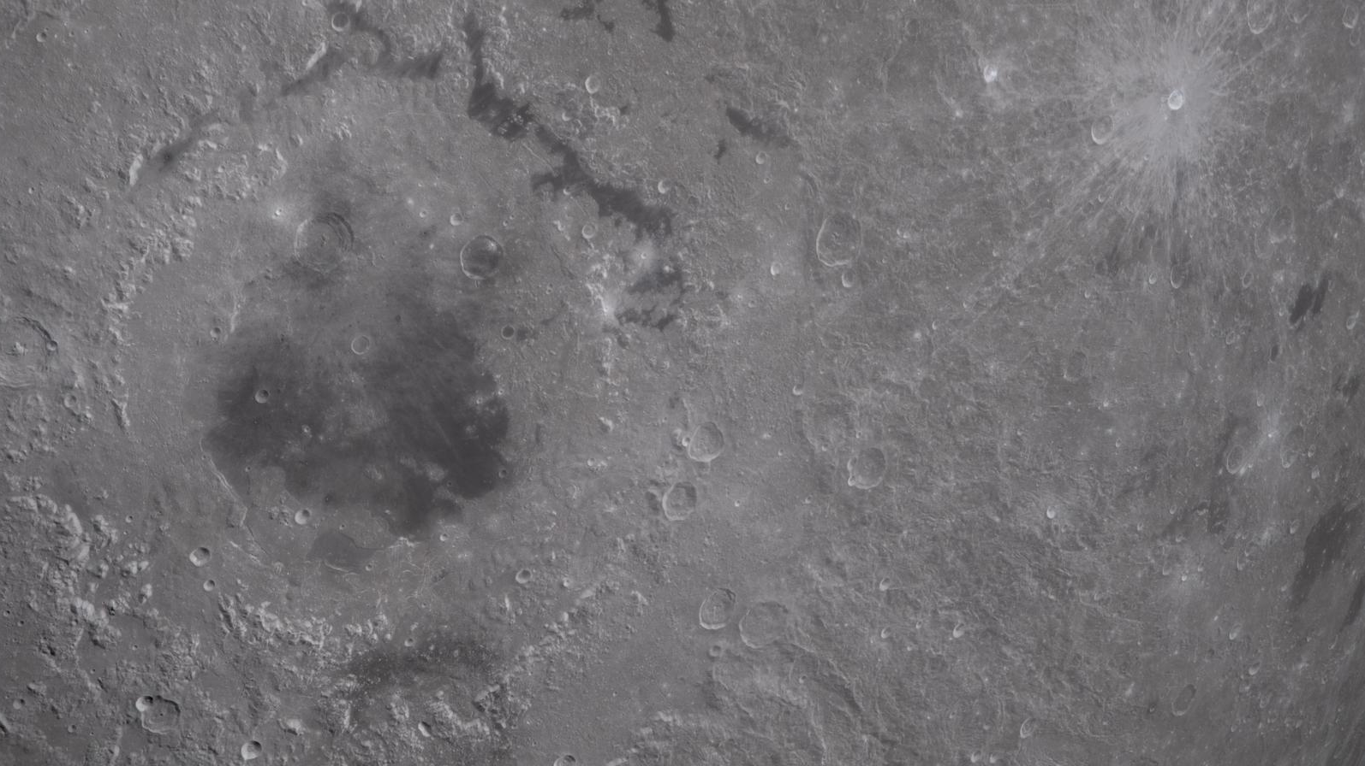
Orientale Basin
Impact basin; multiple rings
Formed ~3.7 billion years ago, by an asteroid 65 km wide travelling 15x faster than a bullet
Approximately one-trillion Hiroshima bombs
Notes:
Impact Basin with multiple rings;
930km across
~3.7 Ga
~65 km impactor
~15 kilometers per second
~One trillion Hiroshima bombs

Slide 7
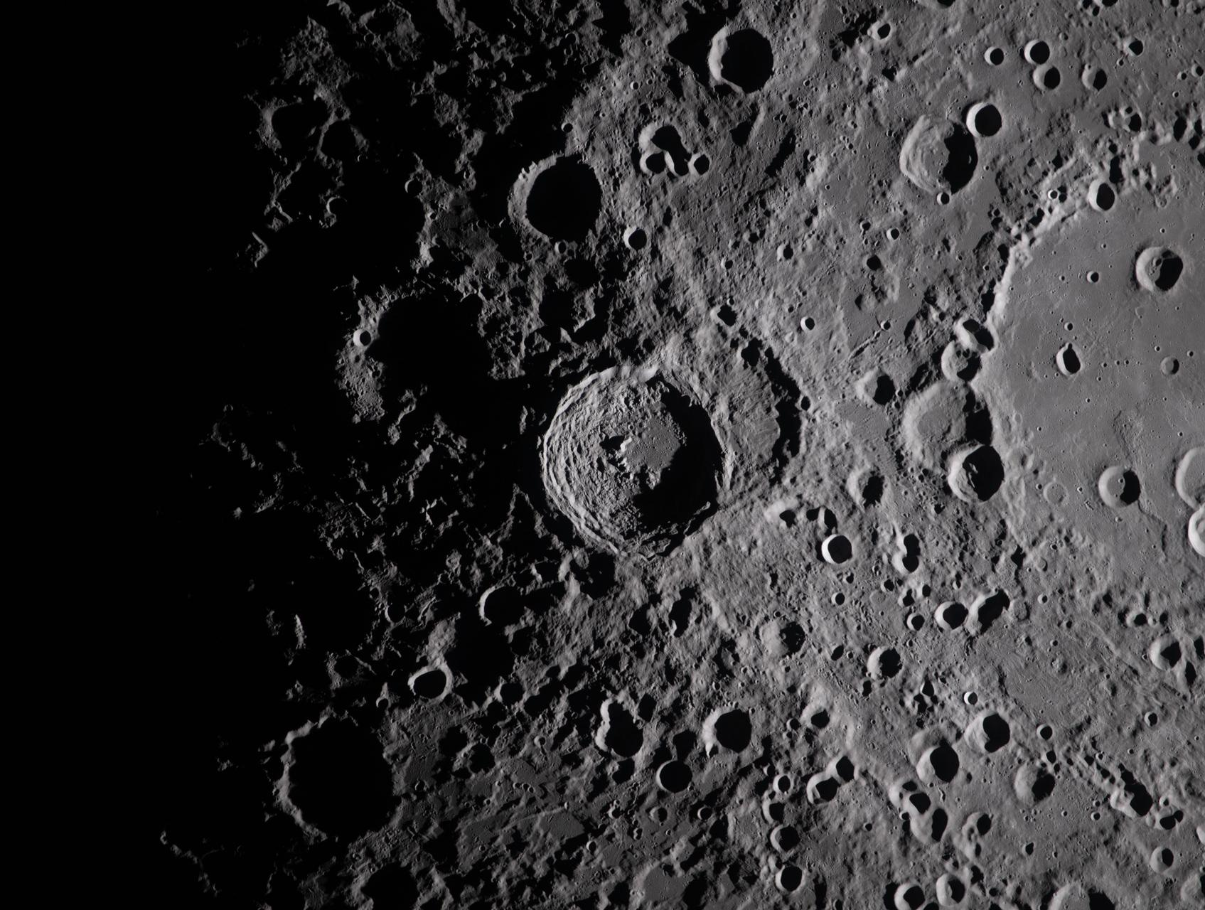
Vavilov Crater
Complex crater; central peak
One-hundred-kilometers across and formed ~1.9 billion years ago
That’s approximately two-billion Hiroshima bombs!
Notes:
Complex crater with a central peak – Hertzsprung Basin
~100 km wide
~1.9 Ga
Peak-ring crater mention (this, but with an added ring)
Age via crater counting (explain)

Slide 8
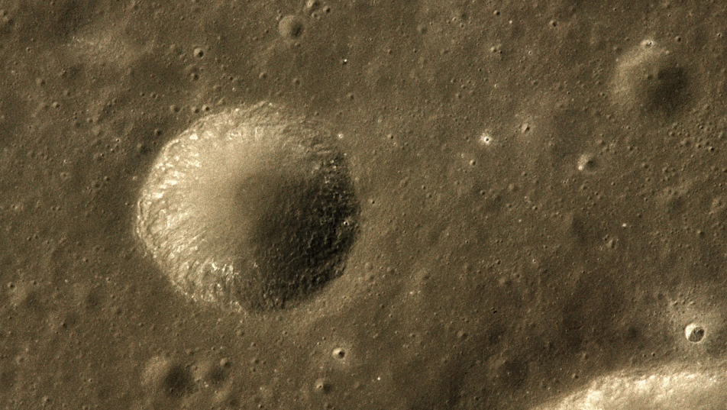
Unnamed Crater
Simple crater; bowl-shaped
Approximately 7 km across; age unknown
Photographed by Apollo 16 astronaut Ken Mattingly
Notes:
Simple crater – as yet unnamed.
7 km wide, age unknown
Apollo 16 – Ken Mattingly
~2000 Hiroshima’s
Within Mendeleev Basin on the lunar farside.

Slide 9
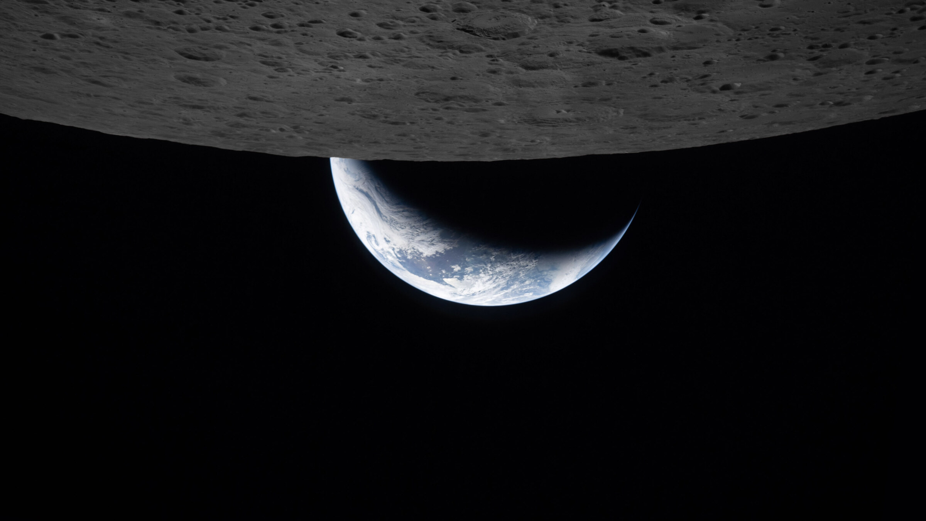
Notes:
Important factors in impact cratering for morphology – impact speed (impact energy), size of impactor, composition of impactor and target, impact angle (most 45-deg)

Slide 10
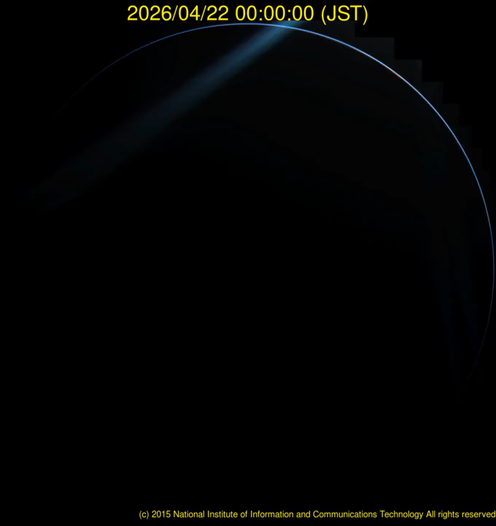
Notes:
Something’s missing…
Where are all the craters on Earth? → Atmosphere (small stuff, 5-100m depending on composition)
Plate Tectonics destroys oceanic crust rapidly (65% of all crust)
Erosion destroys continental craters

Slide 11
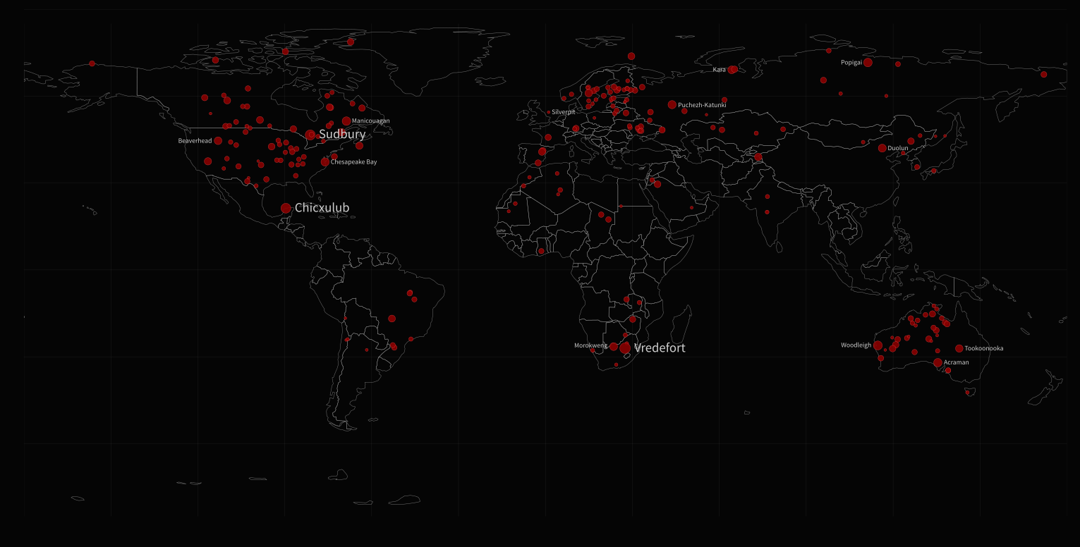
Notes:
220+ terrestrial impact craters discovered, many more lie in wait
Few found in oceans (youngest crust, least explored)… Silverpit in the North Sea closest to us.
Vredefort, Sudbury, and Chicxulub biggest… we’ll be coming back to Sudbury later

Slide 12
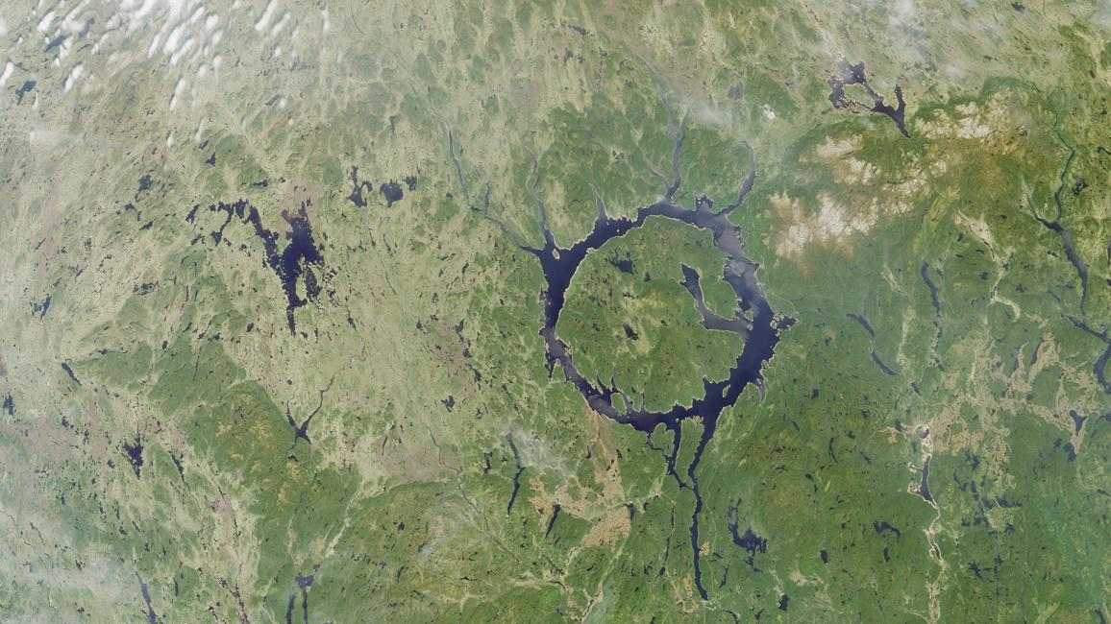
Manicouagan Lake
Multiple-ring structure
Seventy-kilometers across and formed 212 million years ago
Notes:
70 km in diameter, Formed 212 Ma in modern-day Canada
Flooded for hydrothermal power, also used to fish salmon.
Ejecta from this impact is at Churchwood Quarry in Wickwar, Gloucestershire! That’s 2000 km away!
Some craters are very visible…

Slide 13
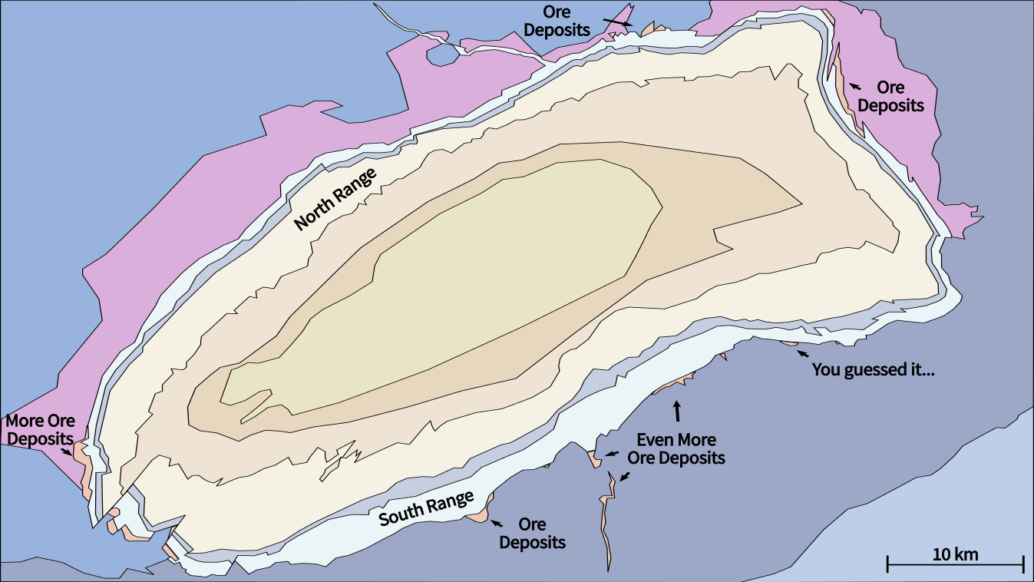
Sudbury Impact Structure
Impact Basin; ~1.85 Ga
Notes:
Others not so much. Introduce Sudbury (Ontario, Canada); the second biggest known crater on Earth. Called an impact structure since it has been eroded & warped by tectonics
1.85 Ga, 200-250km diameter
So, why study it?
Valuable Copper, Nickel and PGE (Platinum, Palladium) in the late 1800s to early 1900s.. ← Very important deposit for landline cables, military armour, power lines, industrial catalysts, and much else.
Analogue for the early Earth, when our first continental crust formed from lava. ← Important for conditions for early life. Could impact craters have formed volcanism that created the conditions for life in the primordial soup?
Could impact craters have formed valuable resources on the Moon, Mars, and beyond?
Two important questions remain. Firstly, how exactly did the melt sheet differentiate?

Slide 14
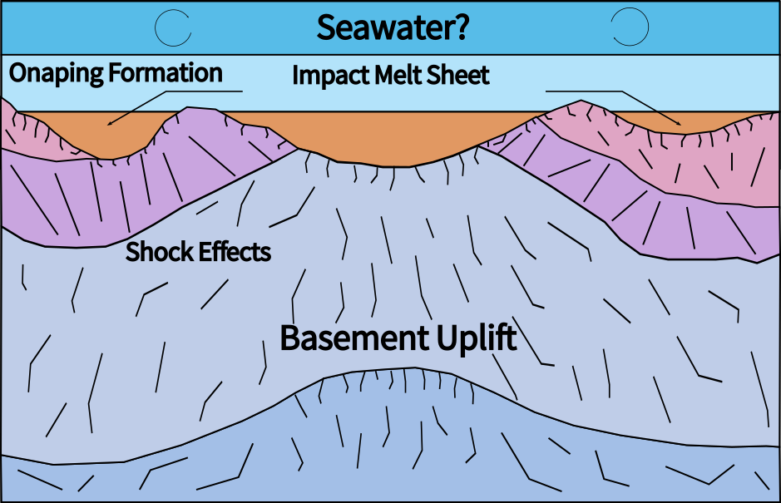
Sudbury Impact Structure
Impact Basin; ~1.85 Ga
~2000 ºC
Notes:
Cross section of melt sheet, with puddles of lava some 2-5km thick, the central melt sheet about 70km in diameter, and at a temperature between 1700 and 2300 C.
Blanketed by the onaping formation breccias (shattered & melted rock)
There’s two competing hypothesis for how this puddle of lava turns into rock, and what products (rock types) we can expect to form from that process.
First up, fractional crystallisation.

Slide 15
Fractional Crystallisation
Sudbury Igneous Complex
Onaping Formation
The first rocks to form, norites, form at ~1200 ºC, and are rich in incompatible elements like Mg, Fe, and Ni
Mafic/Felsic Norite
Notes:
First theory – fractional crystallisation. Very well mixed (homogenous) lava.
Start with an assortment of fruits…
First to form is norites at 1200 C, formed from minerals called pyroxenes, rich in Mg, Fe, and Ni. These mix with plagioclase feldspars containing Ca and Al. These minerals sink into a layer of crystal mush, which eventually solidifies into the norites.

Slide 16
Fractional Crystallisation
Sudbury Igneous Complex
Onaping Formation
Next up at about ~1000 ºC minerals like feldspars become abundant as the incompatible elements run out
These are rich in Si, K, Na, and Al, and settle to form quartz gabbro
Quartz Gabbro
Mafic/Felsic Norite
Notes:
Second at 1000 C is Quartz Gabbro, formed from more compatible elements

Slide 17
Fractional Crystallisation
Sudbury Igneous Complex
Onaping Formation
Eventually, evolved minerals form, including quartz, to form granophyre
Finally, a stratigraphy of rock types is formed via fractional crystallisation
Granophyre
Quartz Gabbro
Mafic/Felsic Norite

Slide 18
Viscous Emulsion
Sudbury Igneous Complex
Onaping Formation
Rapid segregation of different lavas, like oil and water, with compositions inherited from the target (what the asteroid hit)
The result looks a lot like what we saw for fractional crystallisation…
how could we tell the difference?
Granophyre
Quartz Gabbro
Norites
Notes:
Second theory; viscous emulsion. Inhomogenous (poorly mixed) lava rapidly splits like oil & water (by density) before gradually cooling into the rock units we see today.

Slide 19
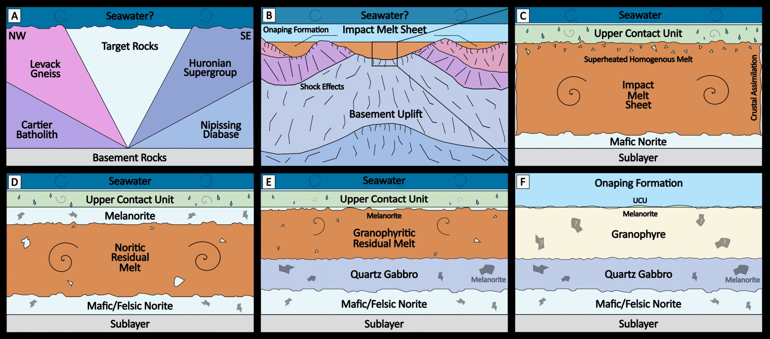
Where are the Roof Rocks?
Sudbury Igneous Complex
Sudbury Igneous Complex
Impact Melt Sheet
Notes:
Sudbury has its own enigmas and solving them may put this debate to bed…
Most layered intrusions (big, km-thick pools of lava) have a “roof unit”, a layer of rocks that formed from the top where the most cooling occurred. At Sudbury, we’ve had some trouble finding it, but recent work has proposed Melanorite as the solution. If we could prove melanorite as a roof layer…

Slide 20
Where are the Roof Rocks?
Sudbury Igneous Complex
Sudbury Igneous Complex
Impact Melt Sheet
Notes:
So, we’ve got an idea of the differences between fractional crystallisation and viscous emulsion and how the roof unit, called melanorite, could help us solve this dilemma.
But how do we go about proving melanorite as a roof unit? Enter SEM.

Slide 21
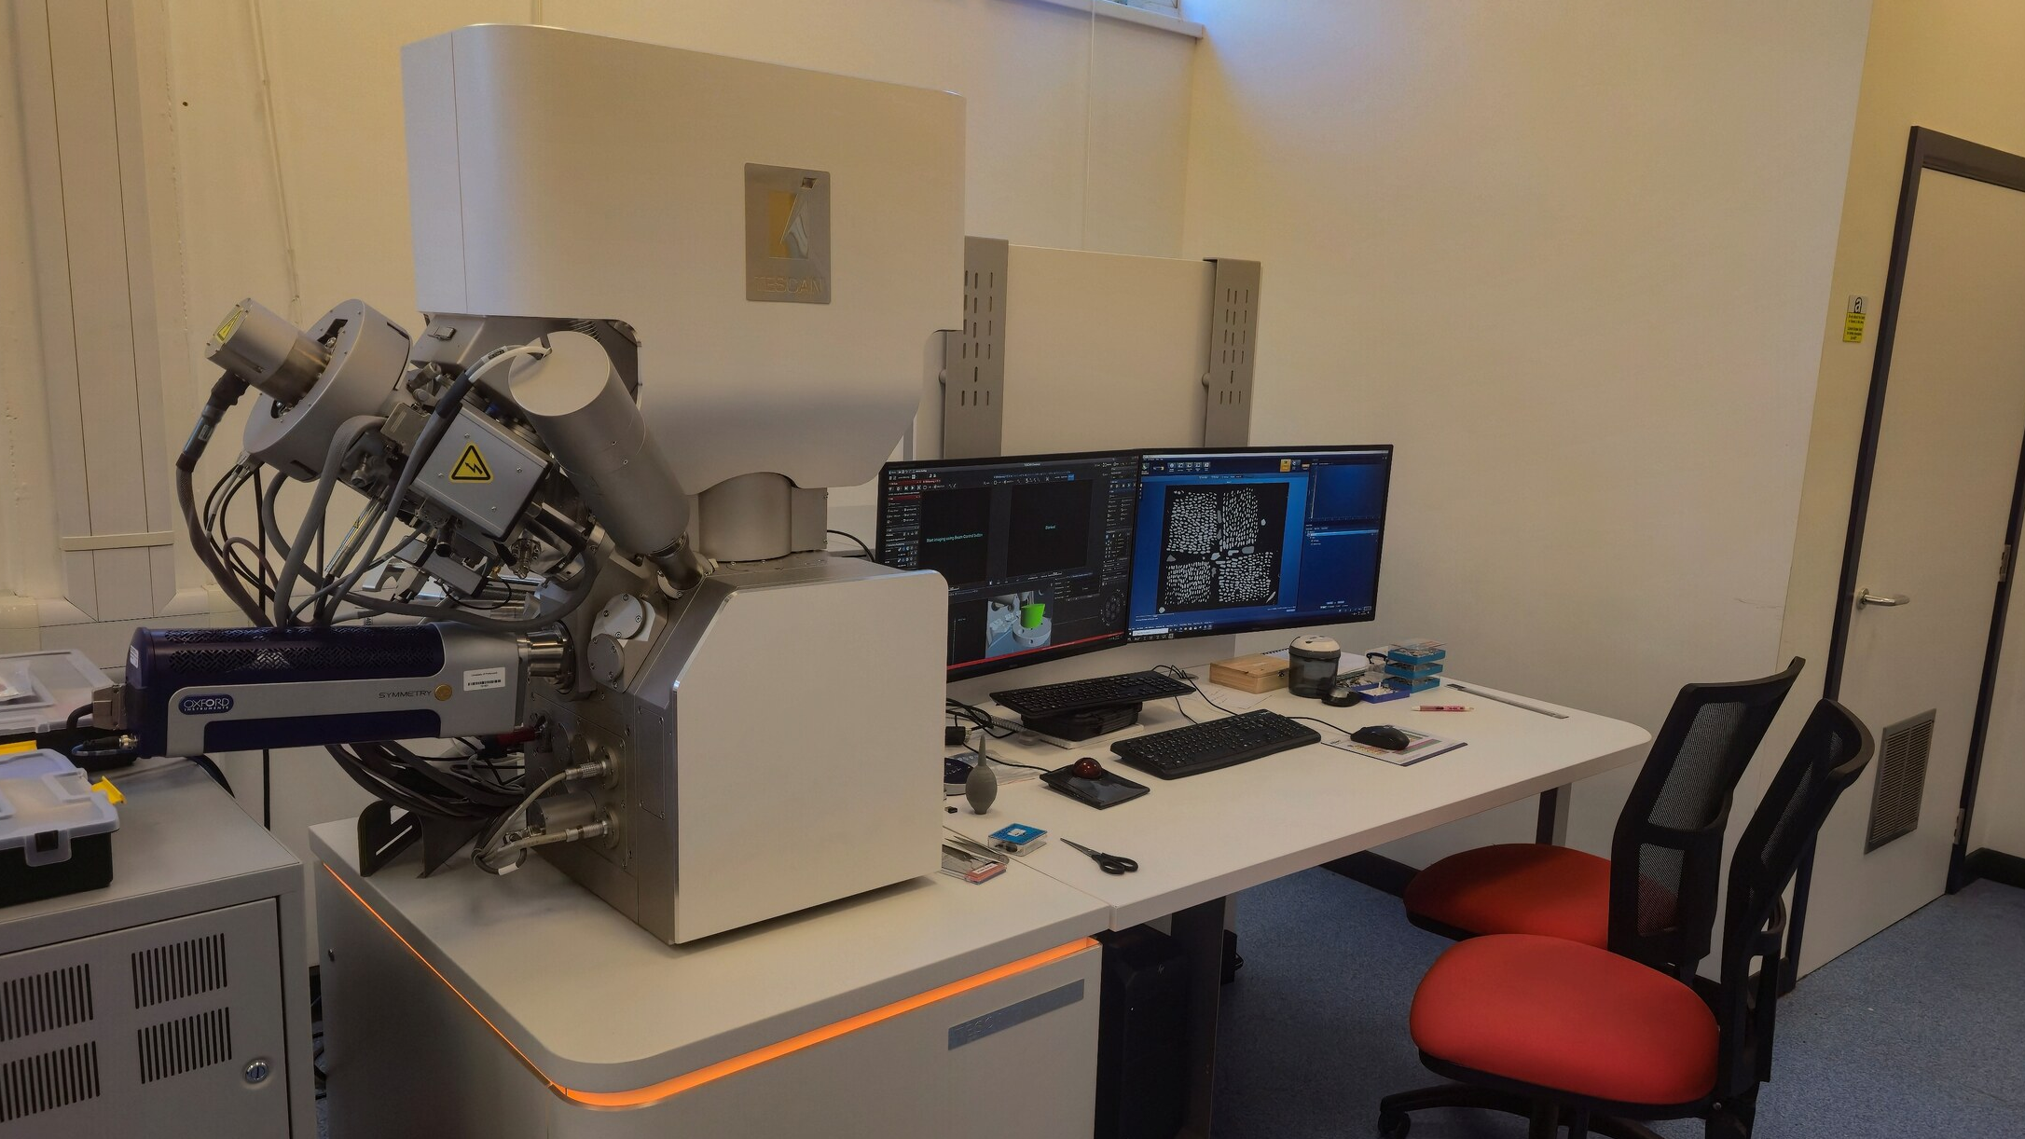
SEM
Scanning Electron Microscopy
Notes:
We use a scanning electron microscope! Light isn’t enough for objects this small, so electrons are needed. Unlike a regular microscope, this uses electromagnetic lenses to focus and steer a beam of electrons.
This is Portsmouth’s “biggest, baddest” system, but we also have 3 others for less demanding tasks.

Slide 22
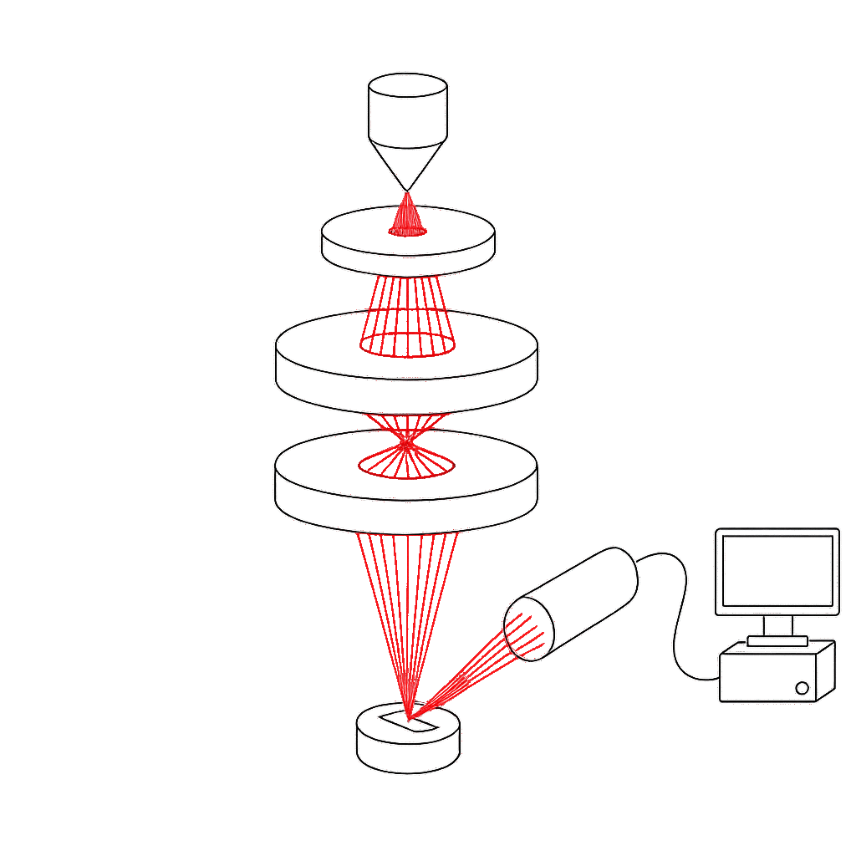
SEM
Scanning Electron Microscopy
Electron Gun
Accelerator
Magnetic Lenses
Computer
(attached to a very happy Ari)
Detector
Sample
Notes:
Whistle-stop SEM tour…

Slide 23
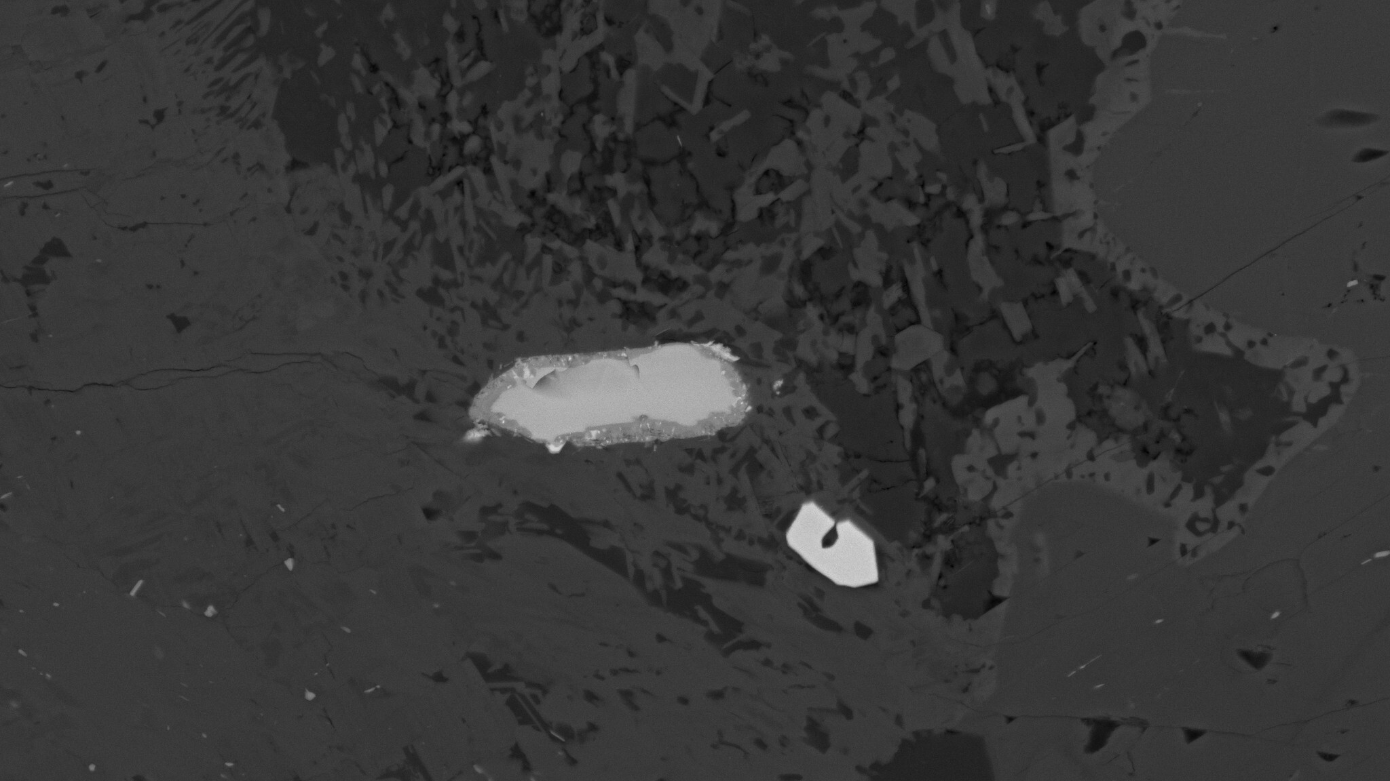
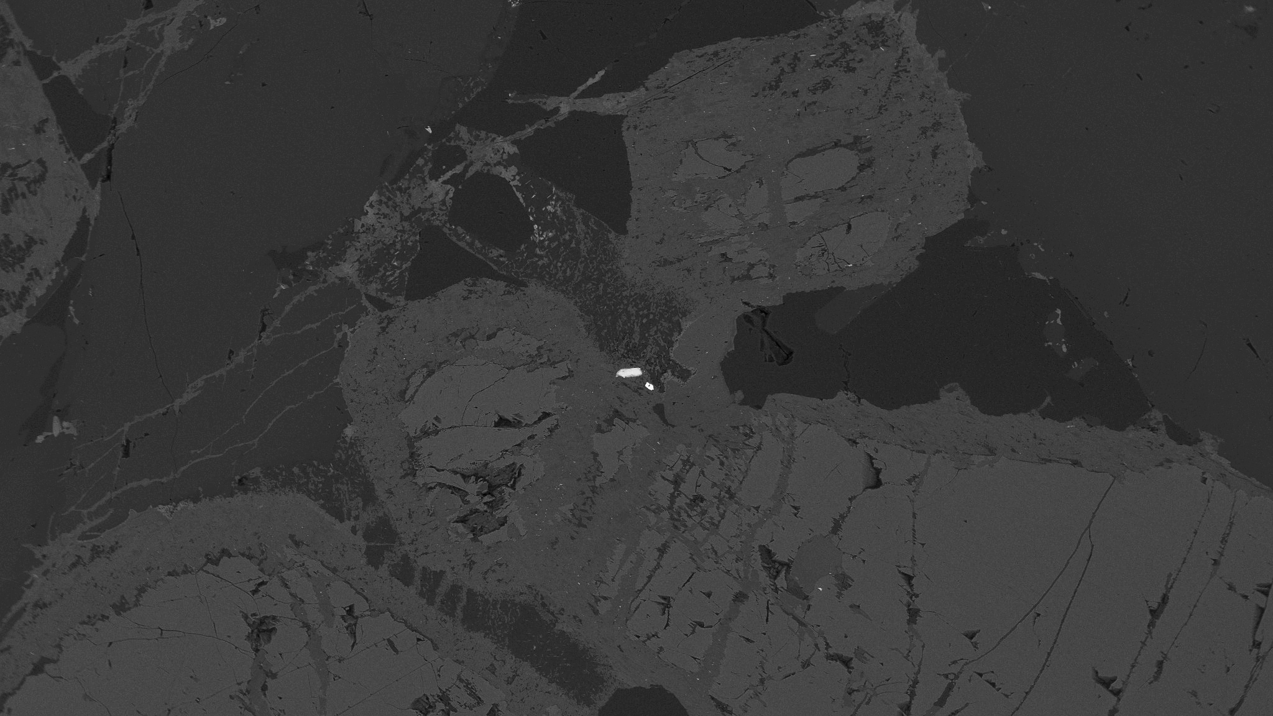
SEM-BSE
Back-Scattered Electron
Notes:
SEM-BSE bright = high atomic mass, dark = low
Baddeleyite = Zr, high mass. Lighter things may contain more Ca, O, Mg.
*click*
At about 3000x we can see textures in the grain.
Thin human hair, 50 micrometers

Slide 24
EBSD
Electron Back-Scatter Diffraction
Notes:
EBSD! Detector Circled

Slide 25
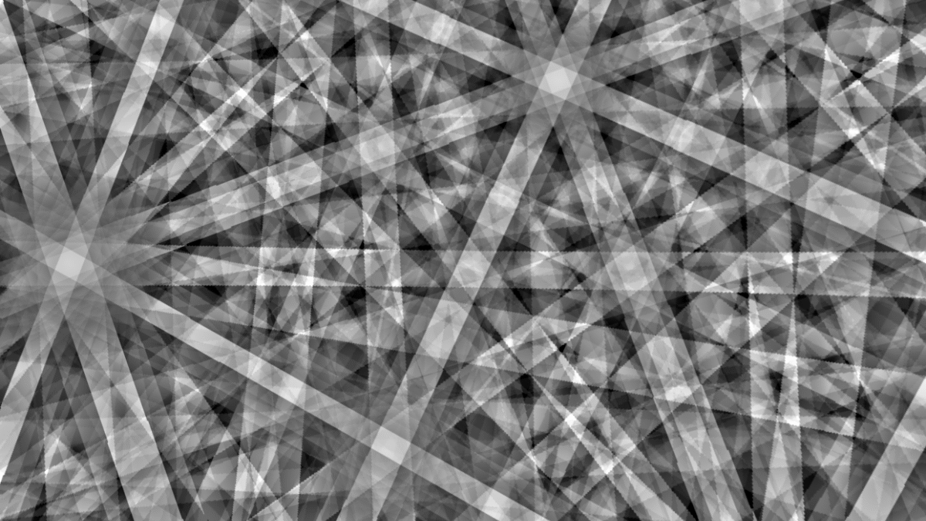
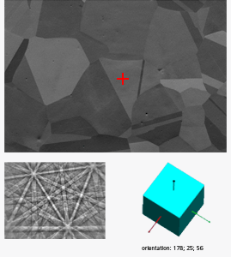
EBSD
Crystal Orientation & Kikuchi Bands
Notes:
Minerals have different crystal structures, which EBSD can detect. Electrons “skip” off the surface off the sample and interfere with the crystal lattice, forming a diffraction pattern.
Kikuchi bands that depend on crystal orientation.

Slide 26
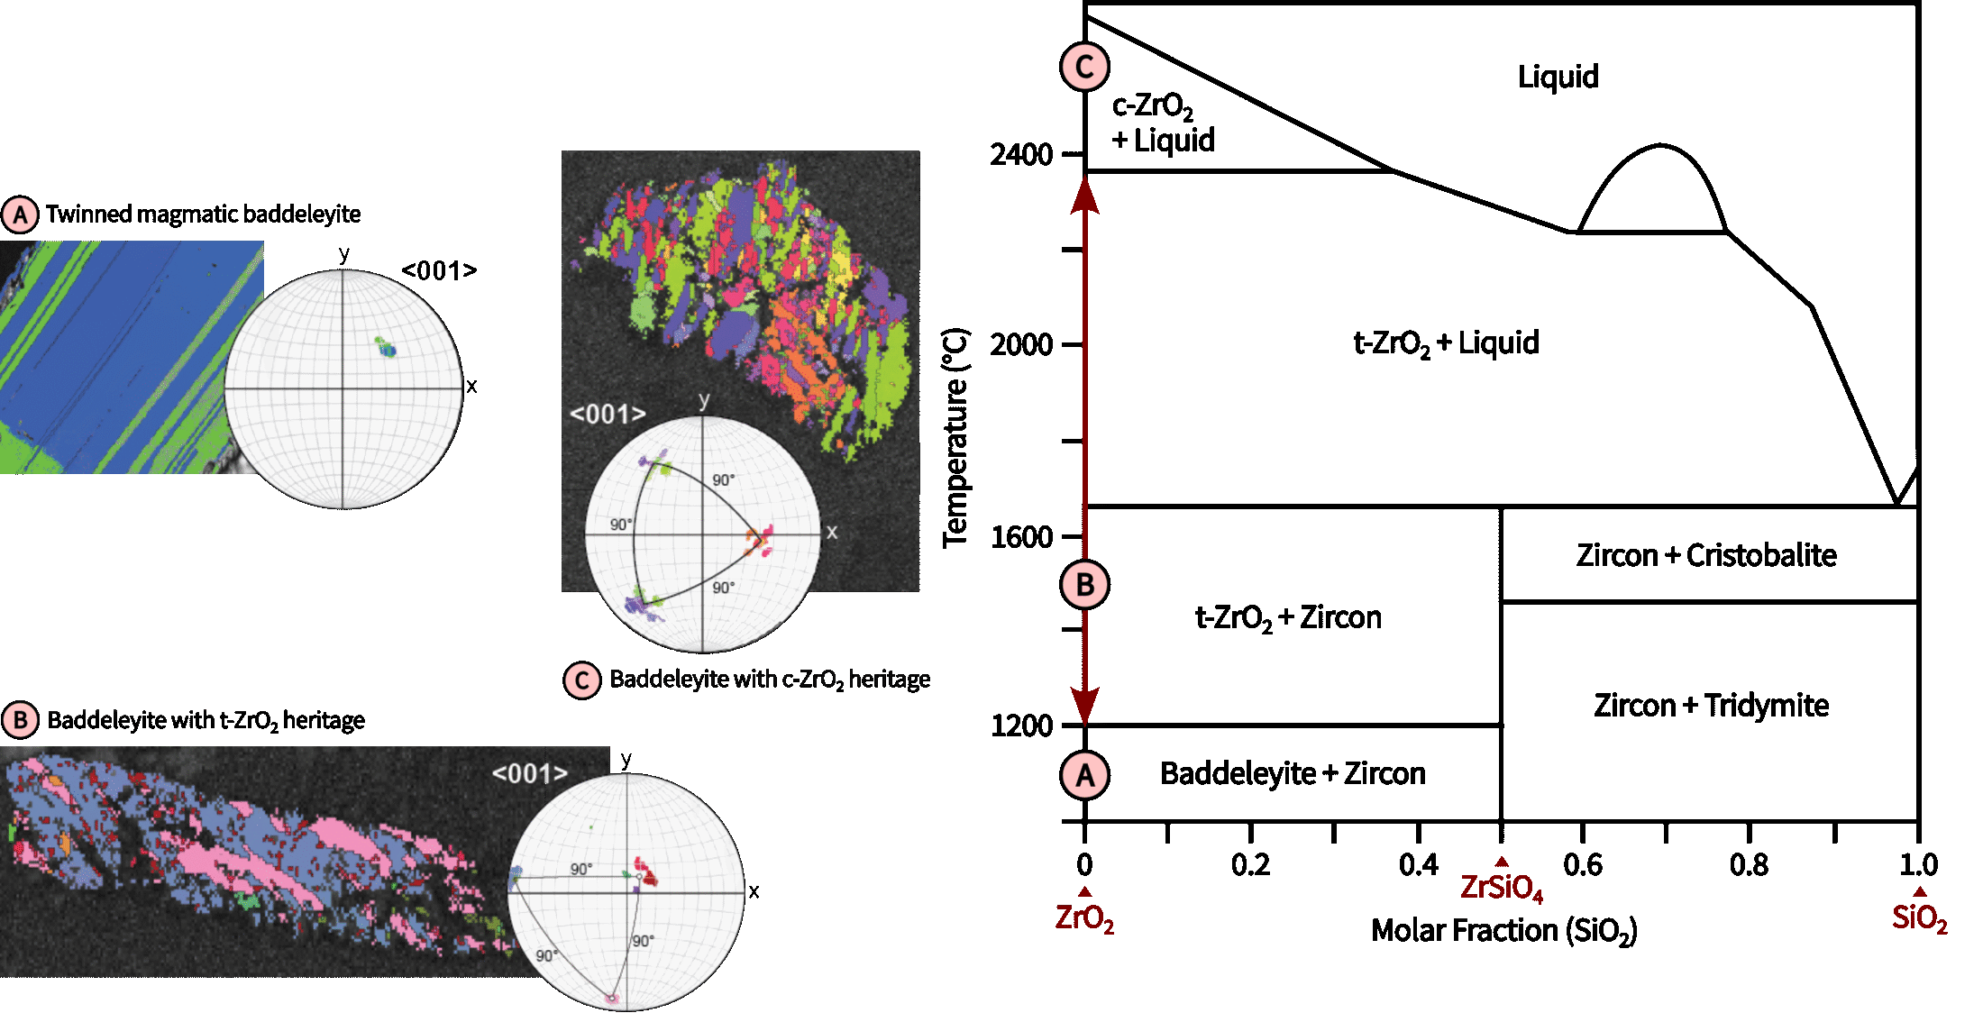
Phase Heritage
Using Zirconia High-T Polymorphs
Notes:
Baddeleyite is a super handy mineral as it can tell us about past temperatures….
Monoclinic (the boringest baddeleyite)
Tetragonal (~1200-1600)
Cubic (2370+) ← Impact diagnostic as volcanism not enough

Slide 27
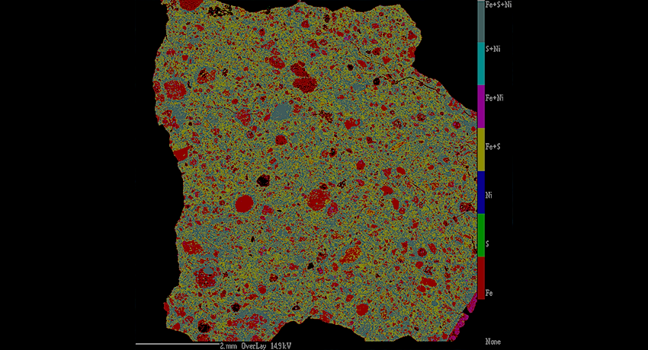
EPMA
Electron Probe Micro Analysis
Used to analyse the composition of specific minerals in a sample
Notes:
Yet another SEM-technique, used to analyse the composition of specific minerals.

Slide 28

Thermodynamic Modelling
Using Data From EBSD & EPMA
By applying temperature constraints and mineral chemistry, we can model melt sheet conditions
This includes the melt sheet composition, formation mechanism, or ore generation
Notes:
Temp constraints + mineral chemistry allow modelling
Fractional crystallisation vs viscous emulsion

Slide 29
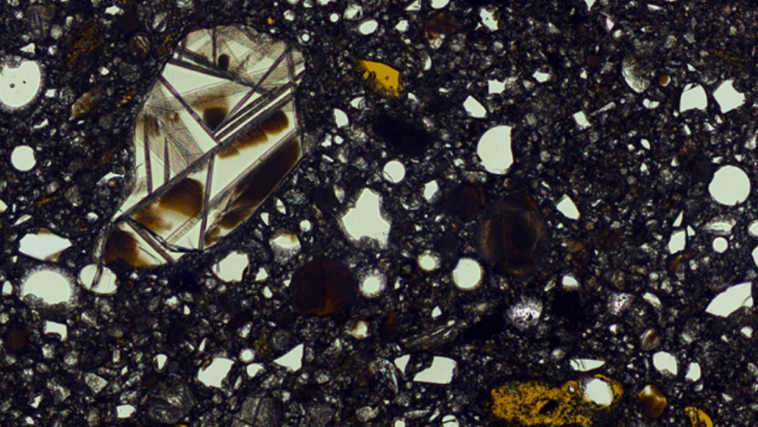
Extraterrestrials!
Apollo & Lunar Meteorite Samples
Can baddeleyite rewrite the story of the Apollo Mg-suite?
Notes:
Apollo Mg-suite ← Currently thought to be volcanic… but are they? And how can zirconia tell us?
If cubic baddeleyite present, then rocks contain melt sheet products

Slide 30
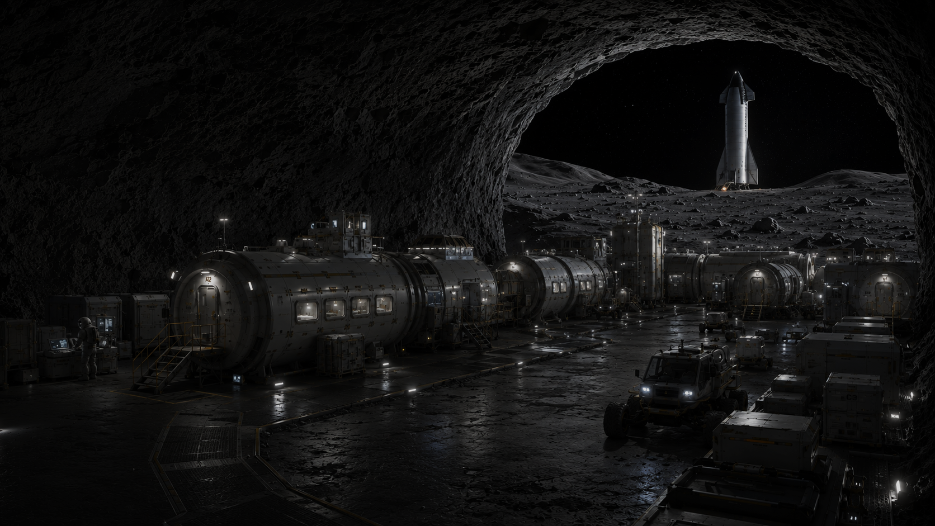
A Look To The Future
How Can Giant Impacts Help Us Next?
How could impact craters help humanity conquer other solar system bodies?
Notes:
I think impact craters get a bad rep…
Generation of life
Important mineral deposits
Getting rid of those pesky Dinosaurs
So how can they help us next?
Ore deposits on the Moon or Mars?
Impact-induced volcanism forming lava tubes on the Moon?
Ice in PSR’s of lunar craters?

Slide 31
Thanks For Listening!
Any Questions?
Ari J. Guest
PhD Student, University of Portsmouth
Notes:
While I may be slightly bias, I hope you’ve gained an appreciation for impact cratering and how it can help us!
Thanks for listening! Any questions?

